Slide 1
Chinook Music Store — Data Analysis Project
Using SQL & Tableau to uncover revenue insights Jaykumar Rathwa| Data Analyst

Slide 2
Project Summary
Dataset: Chinook sample music store database
Tools: MySQL, Tableau Public
Goal: Analyze customer spending, revenue by country & genre, and sales trends
Skills Demonstrated: SQL queries, data aggregation, visualization, and business insights

Slide 3
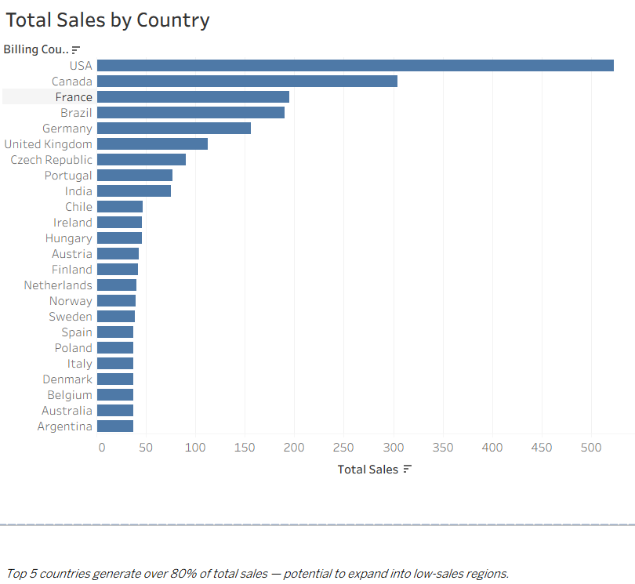
Revenue by Country

Slide 4
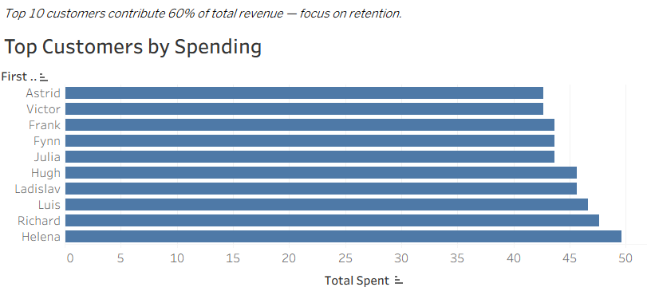
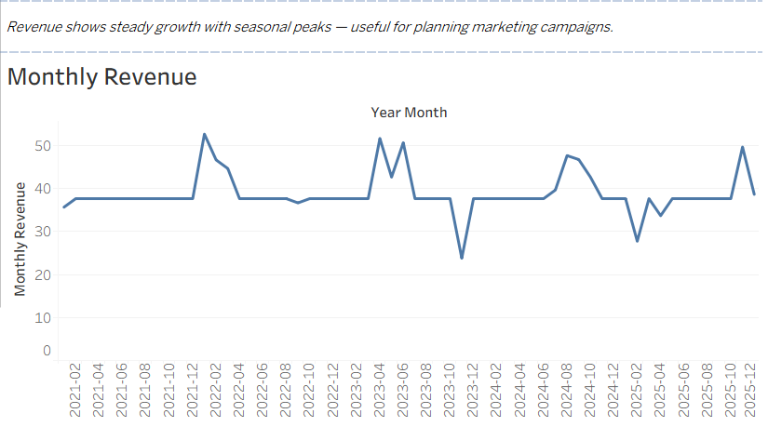
Top Customers by Total Spending & Revenue by Monthly Trend

Slide 5
Key Takeaways
Wrote clean SQL queries with JOINs, GROUP BY, aggregate functions.
Visualized results in Tableau to tell a clear business story.
Demonstrated ability to turn raw data into actionable insights.
Project Repository: https://github.com/rathwaj21/Chinook_SQL_Project
Dashboard: https://public.tableau.com/views/ChinookSQLAnalysisCustomerGenreRevenueTrends/Dashboard1?:language=en-US&publish=yes&:sid=&:redirect=auth&:display_count=n&:origin=viz_share_link

